Slide 1

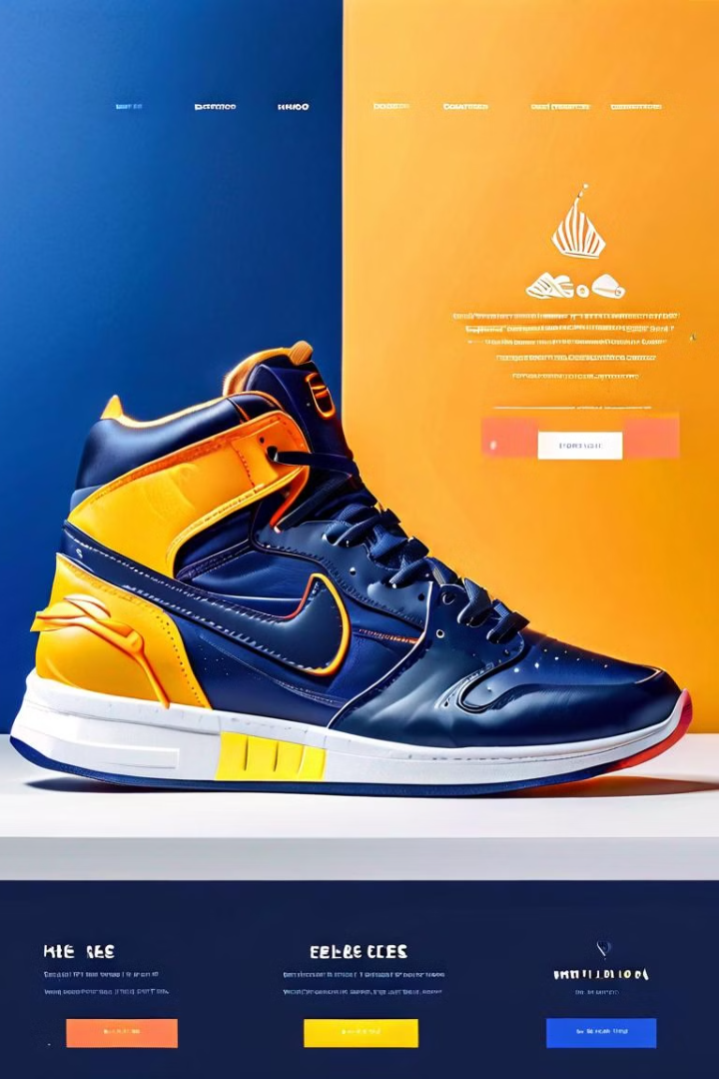


Introduction to Premium Shoes E-Commerce
Welcome to our premium shoes e-commerce platform, where we offer a curated selection of the latest and most sought-after footwear from top brands like Nike and Adidas. Our mission is to provide our customers with a seamless and elevated shopping experience.
by Alish Katuwal

Slide 2
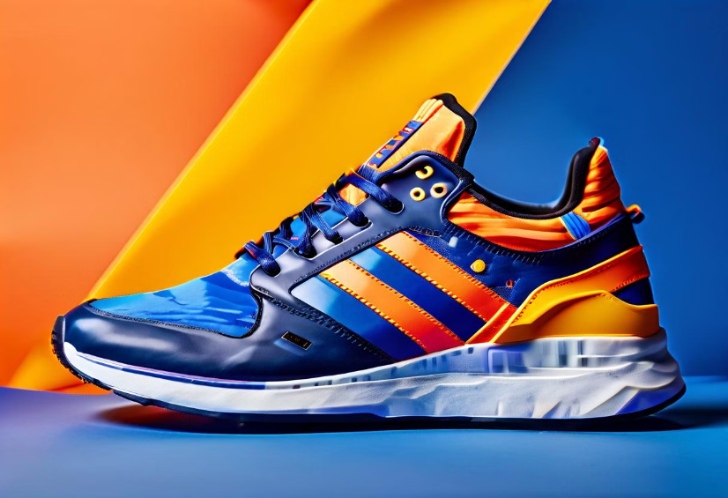
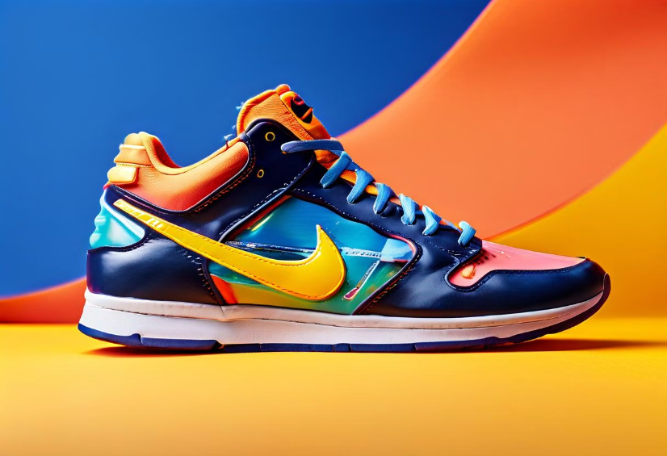
Featured Products: Nike, Adidas
Nike
Adidas
Explore our collection of cutting-edge Nike sneakers, renowned for their innovative design, superior comfort, and unparalleled performance.
Discover the latest Adidas footwear, blending style and functionality to create the ultimate in athletic-inspired fashion.

Slide 3
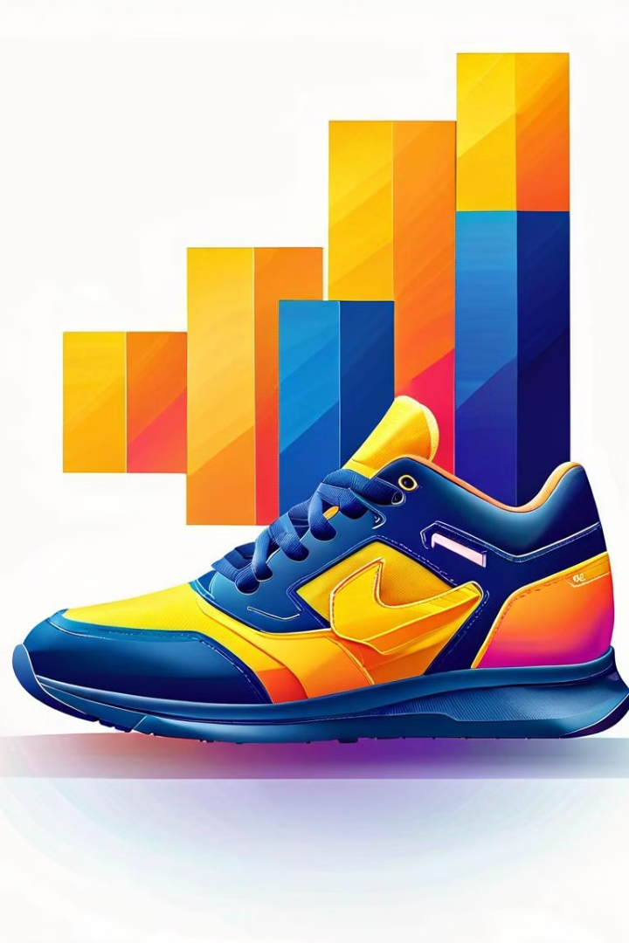
Profitability of the Business
1
Revenue Growth
Our e-commerce platform has seen a steady increase in sales, thanks to our focus on premium products and exceptional customer service.
2
Margin Optimization
By negotiating competitive wholesale prices and streamlining our operations, we've been able to maintain healthy profit margins.
3
Customer Retention
Our loyal customer base and effective marketing strategies have contributed to our strong financial performance and long-term sustainability.

Slide 4
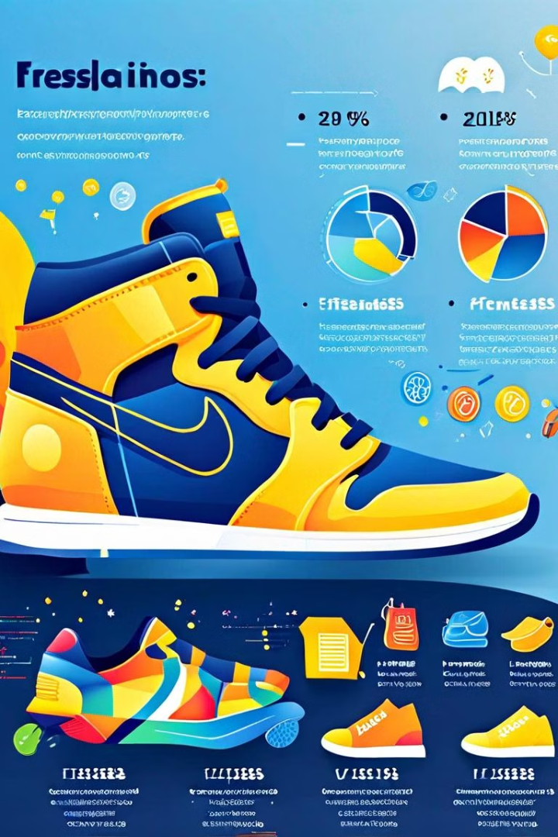
Total Cost Breakdown
Inventory Costs
Operational Expenses
Carefully managing our inventory levels and negotiating with suppliers helps us minimize our capital investment and optimize cash flow.
We've streamlined our operations, investing in efficient logistics and technology solutions to keep our operational costs low.
Marketing Initiatives
Customer Service
Our targeted marketing campaigns and digital advertising efforts help us reach our target audience and drive sales effectively.
Providing excellent customer service, including fast shipping and easy returns, is a key priority and part of our overall cost structure.

Slide 5



Customer Targeting and Segmentation
Affluent Millennials
Active Families
Trend-Setters
Our premium shoe offerings cater to tech-savvy, style-conscious millennials with a higher disposable income and a passion for fashion.
We also target active families looking for durable, high-quality footwear that can keep up with their busy lifestyles.
Our product selection and marketing strategies are designed to appeal to fashion-forward individuals who seek the latest trends in premium footwear.

Slide 6





Marketing and Advertising Strategies
Social Media
Email Marketing
Leverage influential social media platforms to showcase our premium products and engage with our target audience.
Implement targeted email campaigns to inform our customers about new product releases and special promotions.
Influencer Partnerships
Digital Advertising
Collaborate with fashion and lifestyle influencers to reach a wider audience and build brand awareness.
Utilize strategic online advertising channels to drive traffic and generate sales on our e-commerce platform.

Slide 7




Future Expansion and Growth Opportunities
International Expansion
Explore opportunities to expand our premium shoes e-commerce business into new global markets, leveraging our strong brand and logistics capabilities.
Product Line Diversification
Gradually introduce complementary product categories, such as accessories and apparel, to offer our customers a more comprehensive shopping experience.
Omnichannel Approach
Integrate our e-commerce platform with physical retail stores, enabling a seamless and convenient shopping experience for our customers.

